Slide 1
470 PA 1.0 EEG Signals
Space Something-or-Other
Brooks Schafer + Melinda McElveen

Slide 2
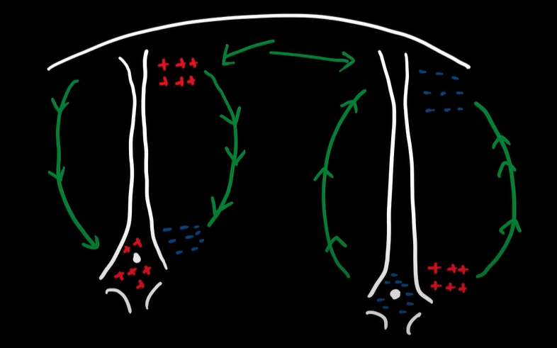
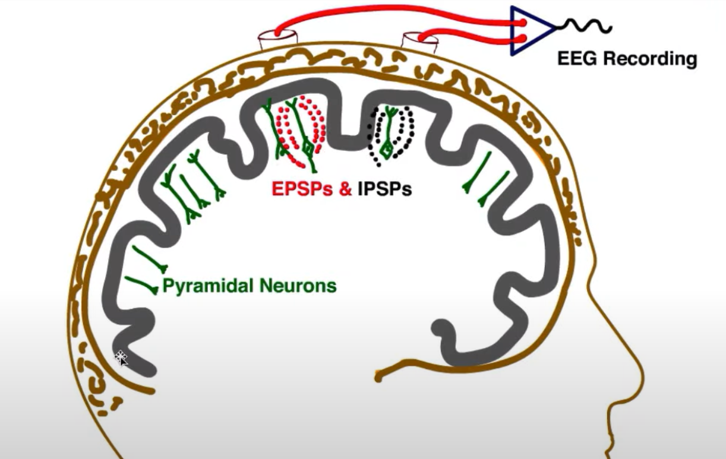
Generation of EEG Signals:
Neurons in the brain communicate with electrical signals (neurotransmitters)
When a presynaptic neuron releases neurotransmitters to a post synaptic neuron, it can cause the post synaptic neurons charge to increase or decrease
An increase in positive charge inside a post synaptic neuron is called an excitatory post synaptic potential (EPSP)
An increase in negative charge inside a post synaptic neuron is called an inhibitory post synaptic potential (IPSP)
When resting, the inside of a neuron is more negative relative to the outside
When post synaptic potentials takes place, it causes dipoles to form outside of the neuron and positive charges flow towards the negative charges, this is what generates EEG signals that can be recorded

Slide 3
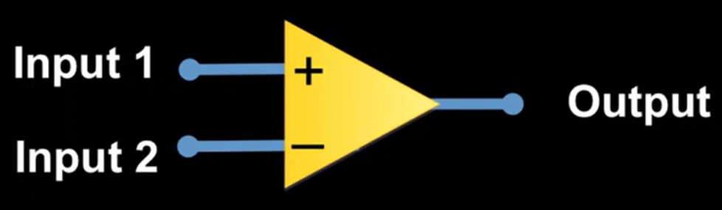
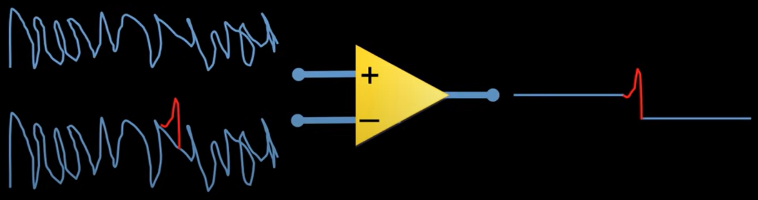
Recording EEG Signals:
EEG signals are recorded with a differential amplifier
A differential amplifier takes 2 electrical inputs and outputs the difference of the 2 signals

Slide 4
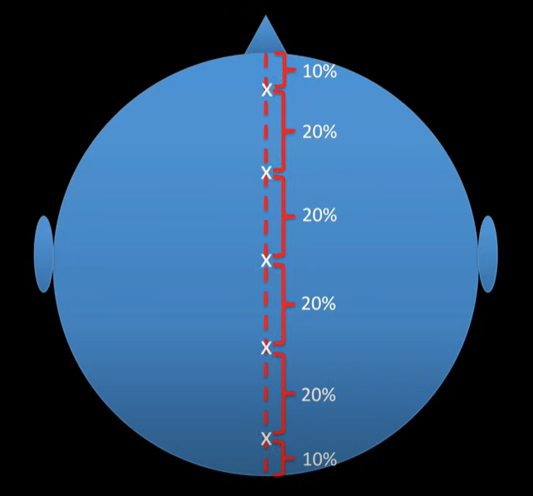
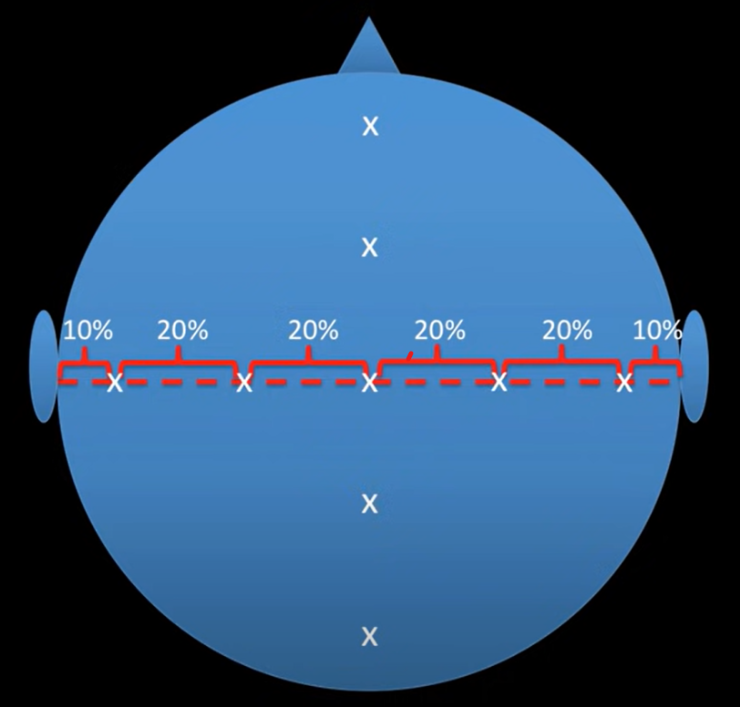
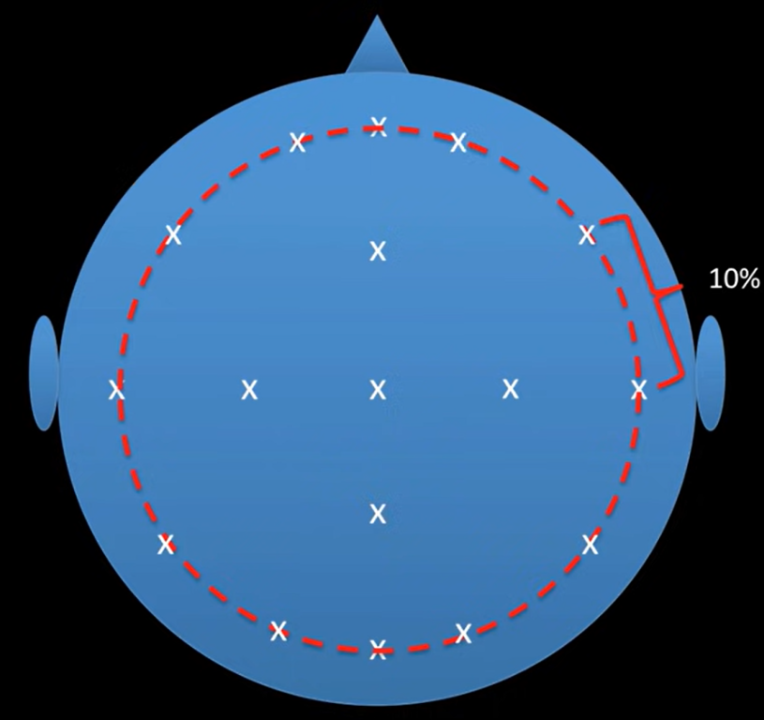
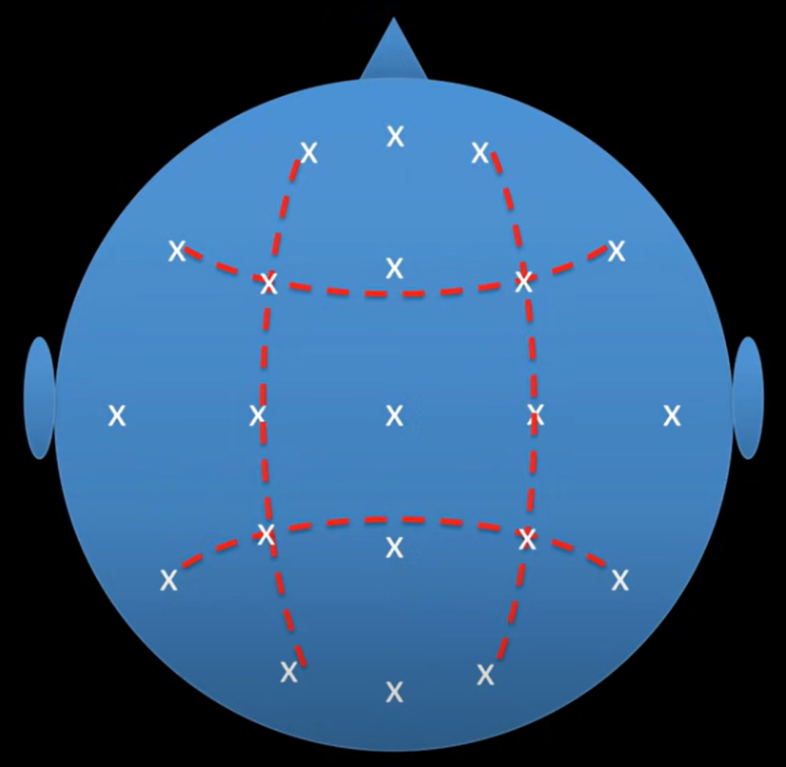
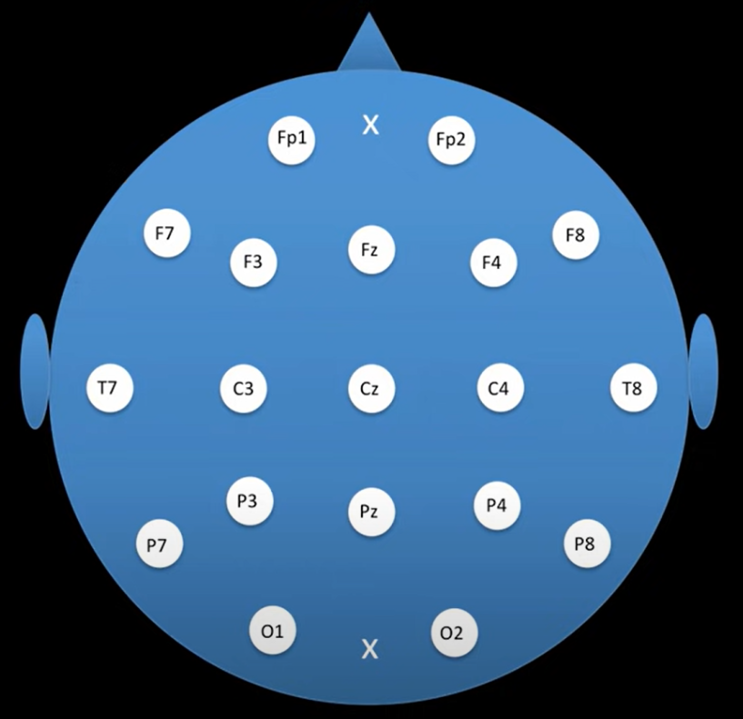
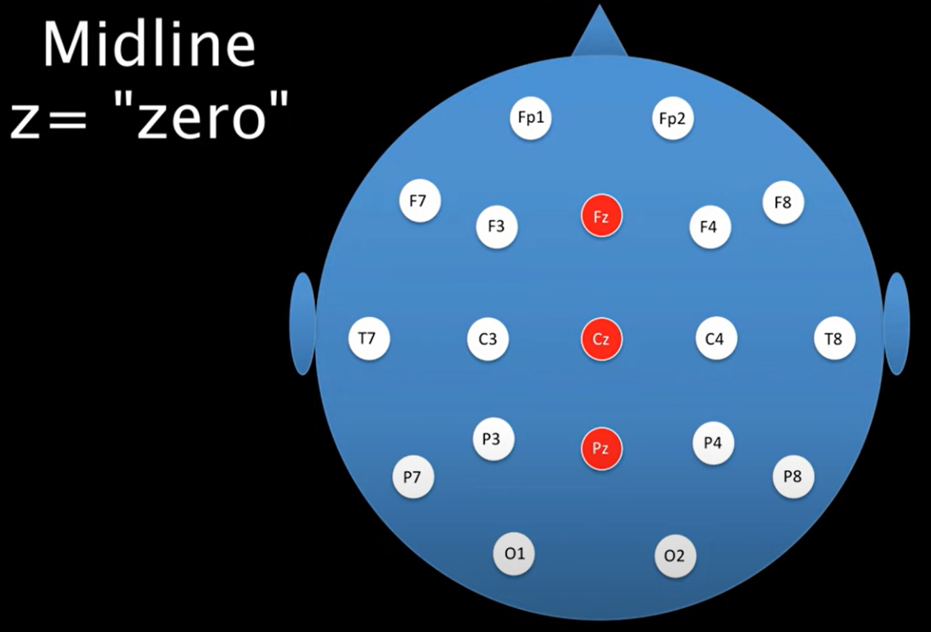
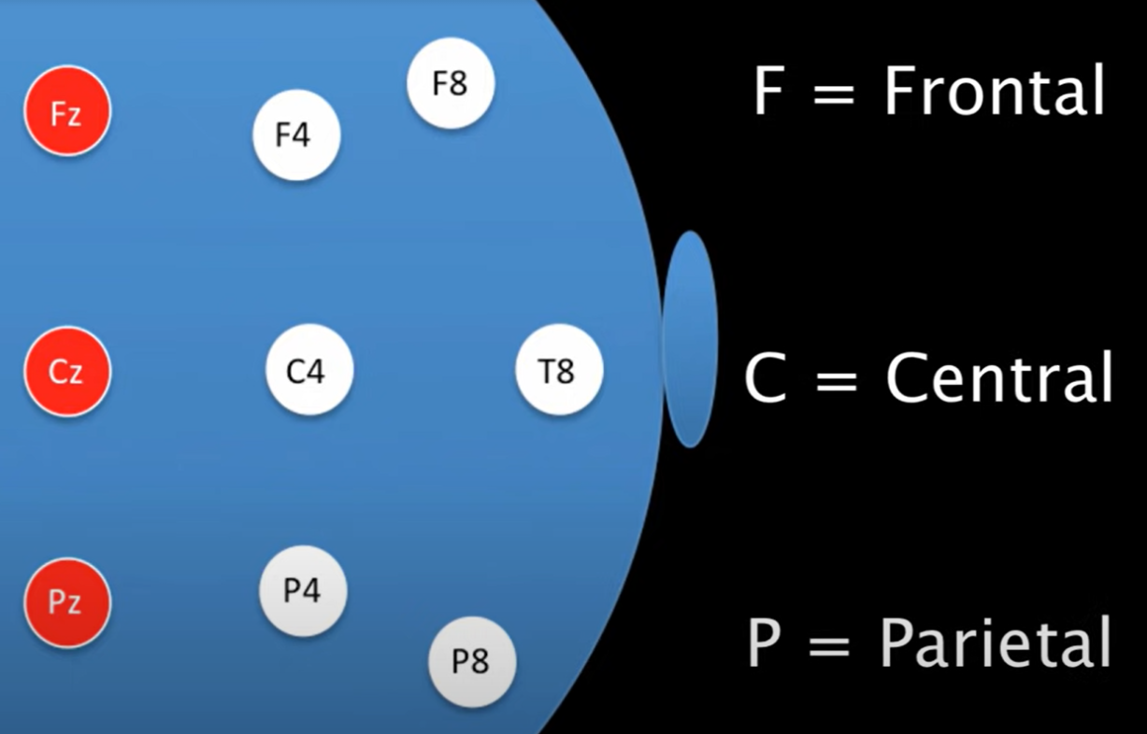
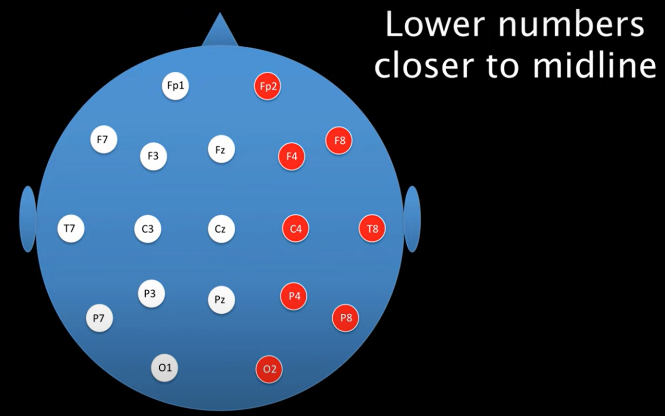
Electrode Placement Scheme:
The 10-20 system is the system by which electrodes are applied to the head and displayed on EEG recordings
Electrodes are placed on the head and labeled as shown below

Slide 5
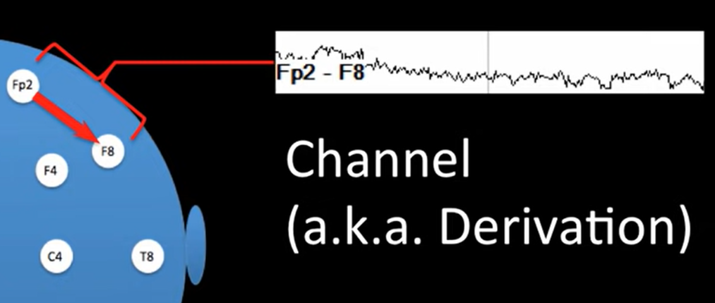
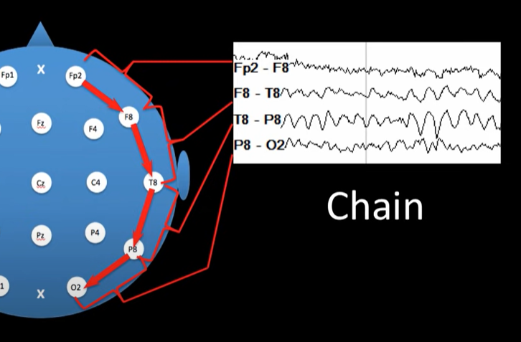
EEG Montages:
A single EEG signal from 2 inputs is called a channel
A series of related channels is called a chain
Different methods of recording and displaying EEG signals are called montages
Montage Schemes:
Bipolar
Common reference
Average reference
Laplacian

Slide 6
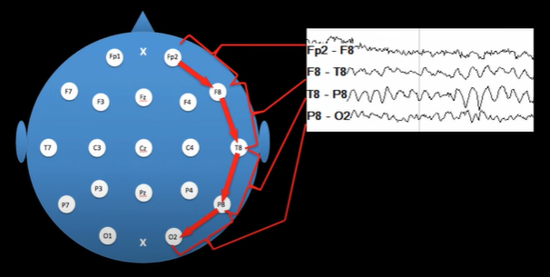
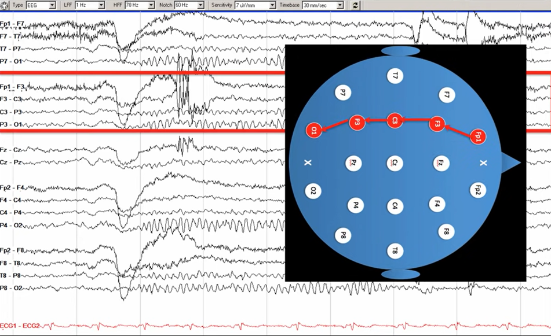
Bipolar Montage:
Compares a single EEG signal to its adjacent neighbor
Chains of these channels are made by continuing to compare adjacent neighbors in a certain pattern depending on the type of bipolar montage
An anterior-posterior bipolar montage would look like the following, with each layer representing a corresponding layer of electrodes on the head
For example, the right temporal chain is made up of the following electrode channels

Slide 7
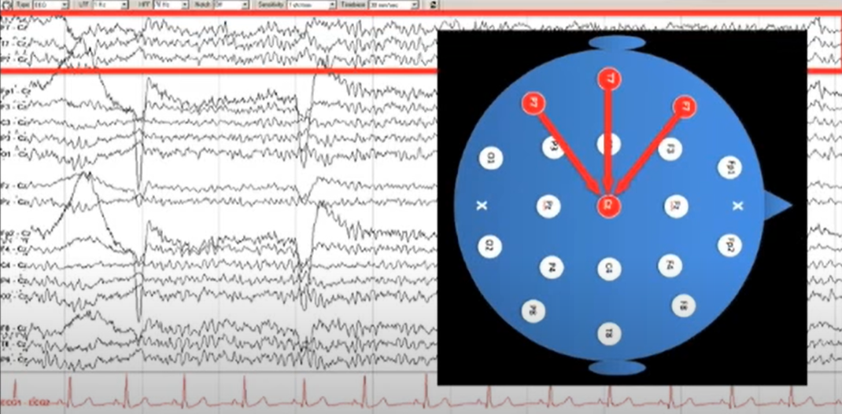
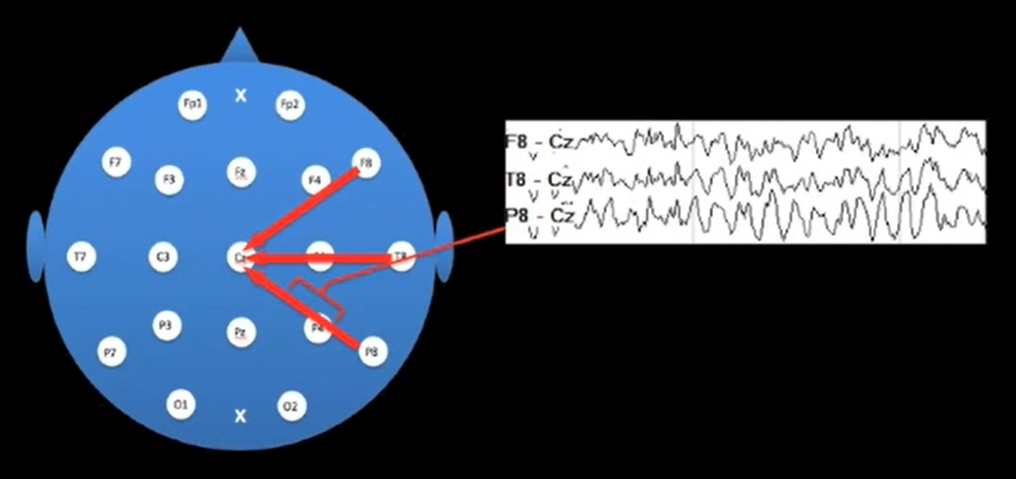
Common Reference Montage:
Compares the signal of every electrode on the head to a single common reference electrode
Most common type is the Cz reference montage
The center electrode (Cz) is compared with all other electrodes to create chains as can be seen in this example
An example of a Cz reference montage:

Slide 8
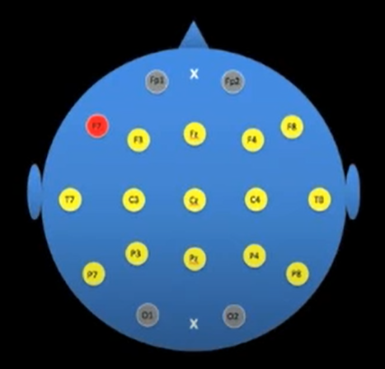
Average Reference Montage:
Compares each electrode signal on the head to the average of the rest of the head
For example, if our reference electrode is F7 (red), its electrode signal would be compared to all the other electrodes (yellow) signals divided by the number of electrodes
Comparison excludes Fp1, Fp2, O1, and O2 because they are easily susceptible to eye and head movement artifacts

Slide 9
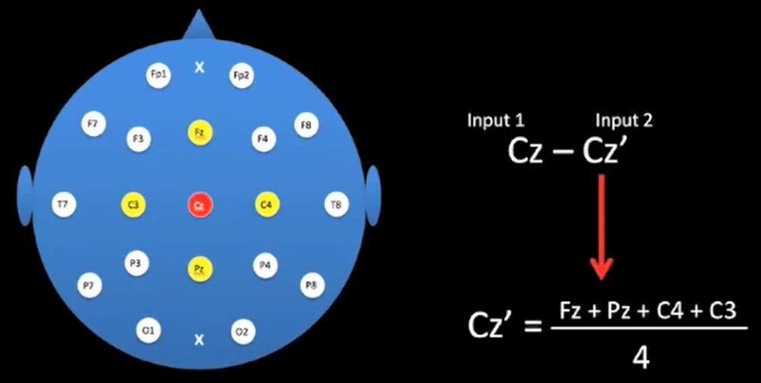
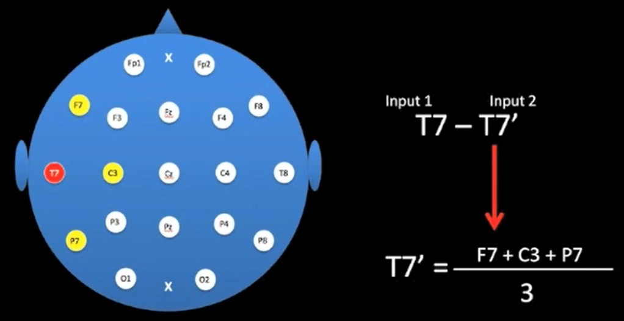
Laplacian Montage:
Compares an electrode with the average of its nearest neighbors
Examples for electrodes Cz and T7 are shown below

Slide 10
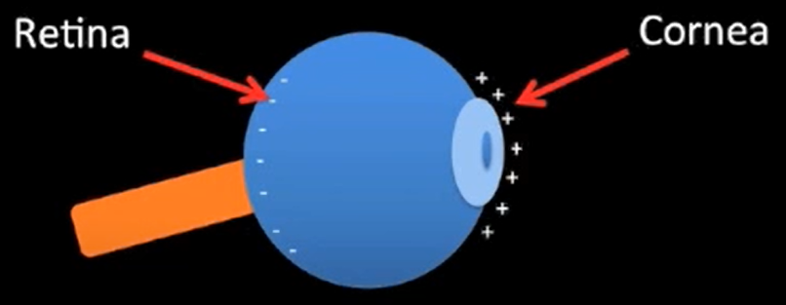
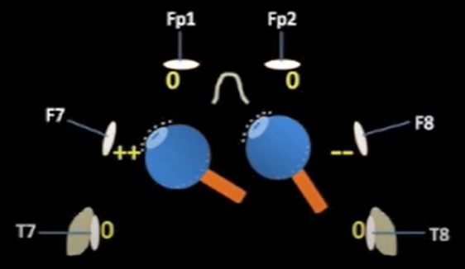
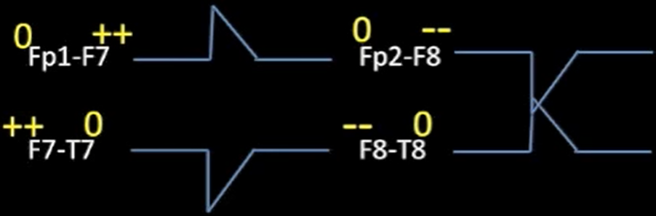
Eye Movement Artifacts:
Eyes are more positively charged in the front and negatively charged in the back
Thus, when we move our eyes, they can create signals that can be detected in EEG recordings
For example, when an eye movement to the left is made, it increases the positive charge of F7 and decreases the charge of F8
The resulting artifacts are shown in the last image

